Slide 1
Dicamba study

Slide 2
21 DAT
Application at 2nd Trifoliate
Dicamba (g ae ha⁻¹)

Slide 3
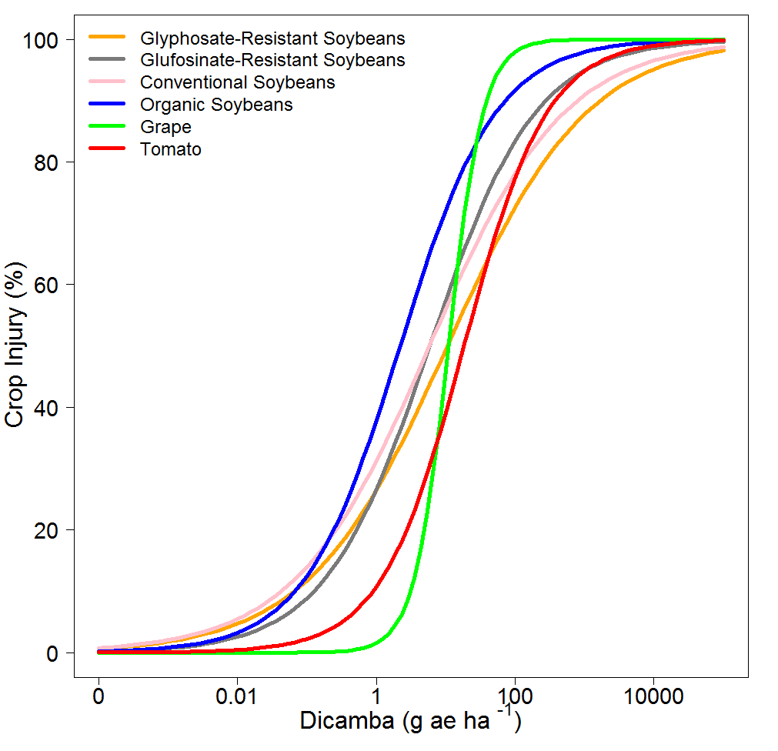

Slide 4
ED values of Dicamba (g ae ha⁻¹) 21 d after application at 2nd Trifoliate
Varieties | ED 10 (SE) | ED20 (SE) | ED30 (SE) | ED50 (SE)
 | g ae ha⁻¹
Glyphosate-Resistant Soybeans | 0.06 (0.04) | 0.43 (0.18) | 1.5 (0.4) | 10.5 (3.2)
Glufosinate-Resistant Soybeans | 0.1 (0.05) | 0.52 (0.16) | 1.3 (0.3) | 5.9 (1.3)
Conventional Soybeans | 0.04 (0.02) | 0.26 (0.09) | 0.9 (0.2) | 5.8 (1.4)
Organic Soybeans | 0.06 (0.02) | 0.24 (0.06) | 0.6 (0.09) | 2.2 (0.3)
Grape | 3.1 (1.1) | 4.9 (1.2) | 6.7 (1.2) | 10.9 (1.8)
Tomato | 0.9 (0.3) | 2.72 (0.7) | 5.7 (1.1) | 18.4 (3.3)

Slide 5
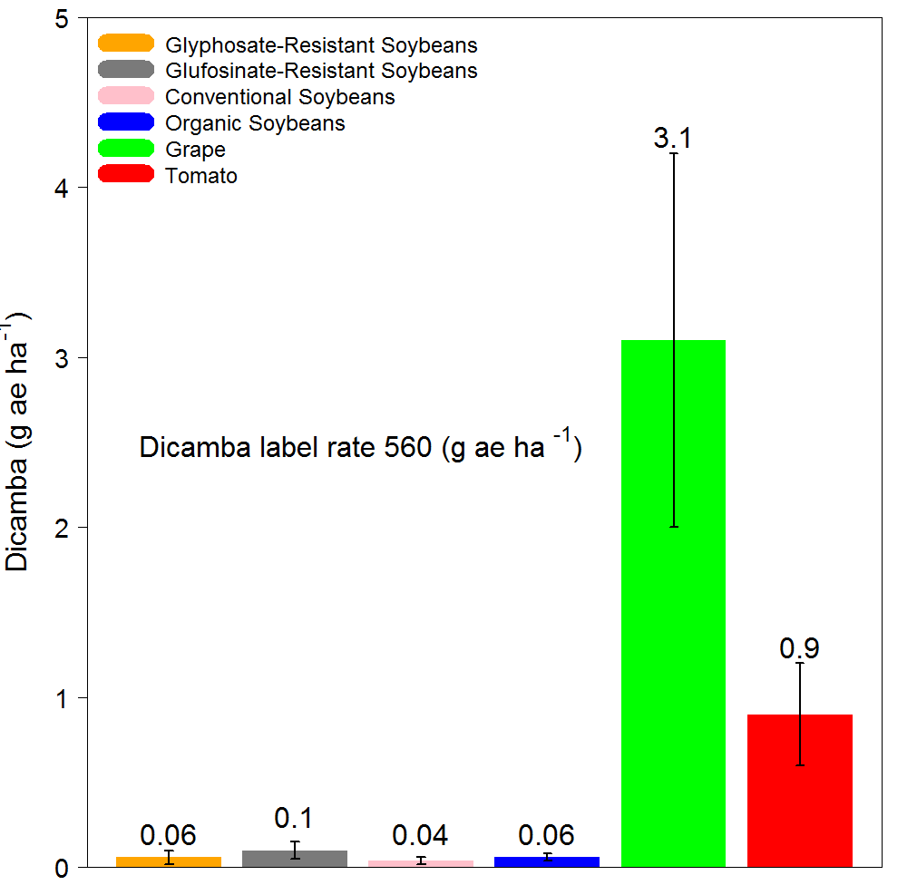
ED 10

Slide 6
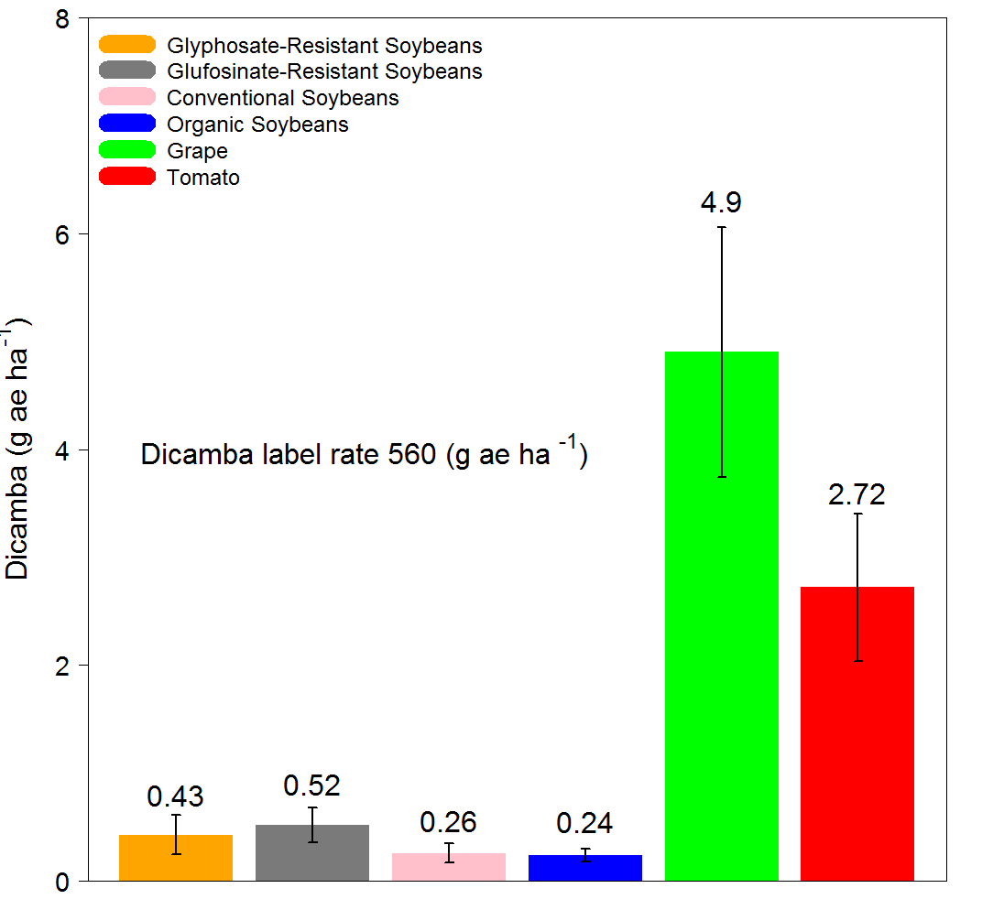
ED 20

Slide 7
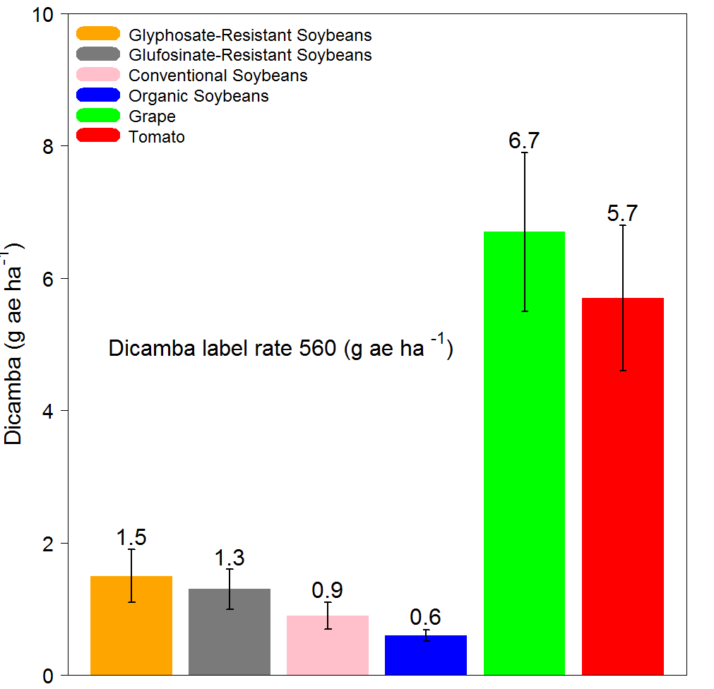
ED 30

Slide 8
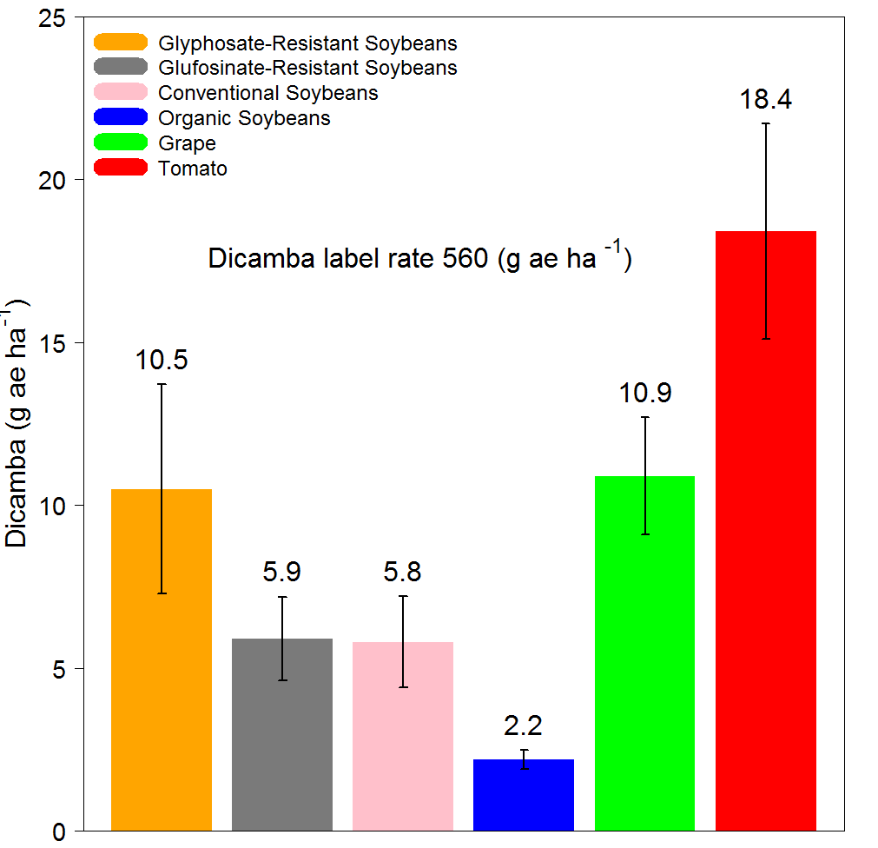
ED 50

Slide 9
21 DAT
Application at R2
Dicamba (g ae ha⁻¹)

Slide 10
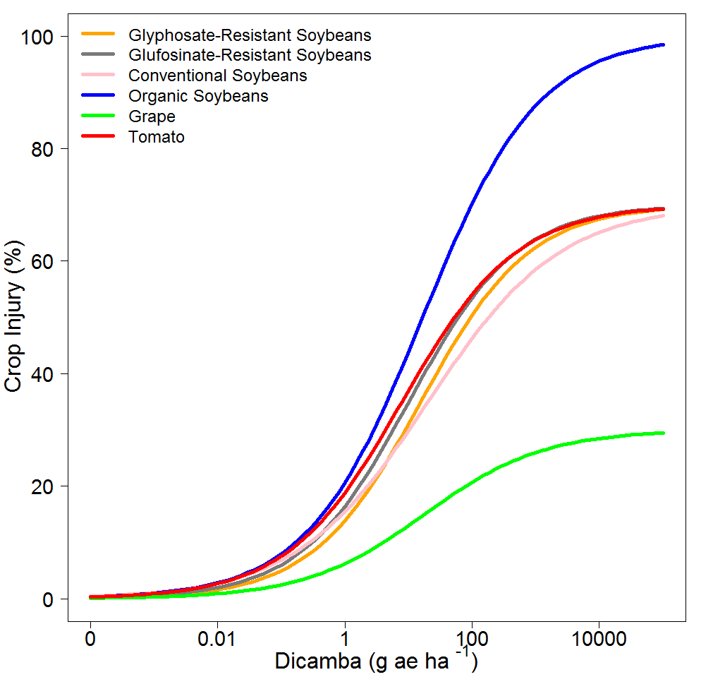

Slide 11
ED values of Dicamba (g ae ha⁻¹) 21 d after application at R2
Varieties | ED 10 (SE) | ED20 (SE) | ED30 (SE) | ED50 (SE)
 | g ae ha⁻¹
Glyphosate-Resistant Soybeans | 0.5 (0.1) | 2.6 (0.5) | 8.9 (1.6) | 95.2 (31.5)
Glufosinate-Resistant Soybeans | 0.2 (0.1) | 1.7 (0.5) | 6.8 (1.7) | 54.9 (19.7)
Conventional Soybeans | 0.3 (0.08) | 2.3 (0.4) | 10.2 (1.8) | 182.7 (64.5)
Organic Soybeans | 0.2 (0.05) | 0.9 (0.2) | 2.8 (0.5) | 16.7 (3)
Grape | 4.0 (1.7) | 79.9 (59.3) | NA | NA
Tomato | 0.2 (0.1) | 1.2 (0.6) | 4.4 (1.8) | 53.1 (39.4)

Slide 12
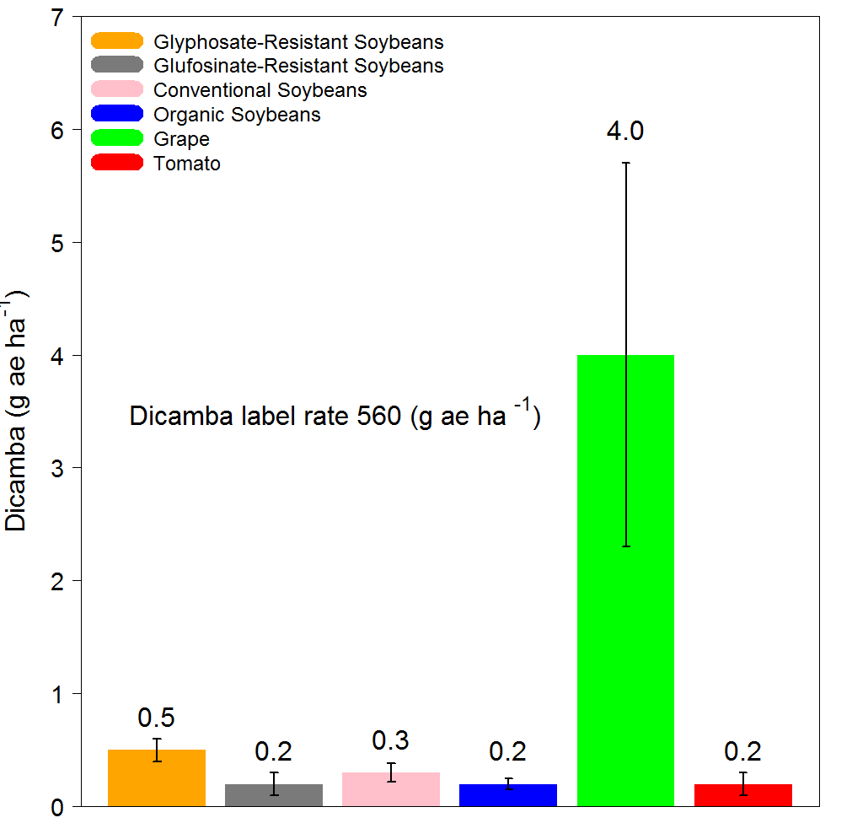
ED 10

Slide 13
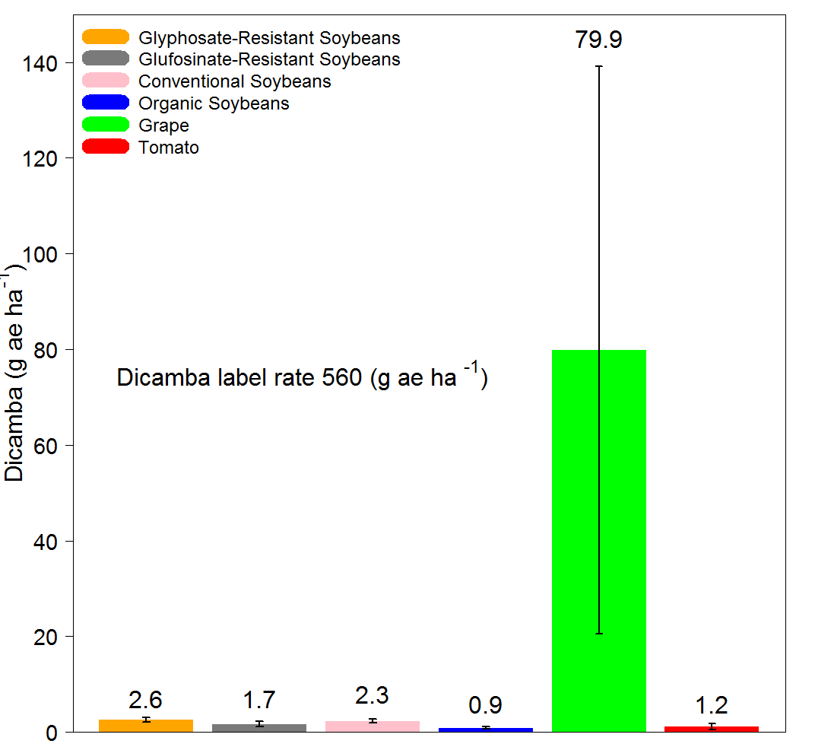
ED 20

Slide 14
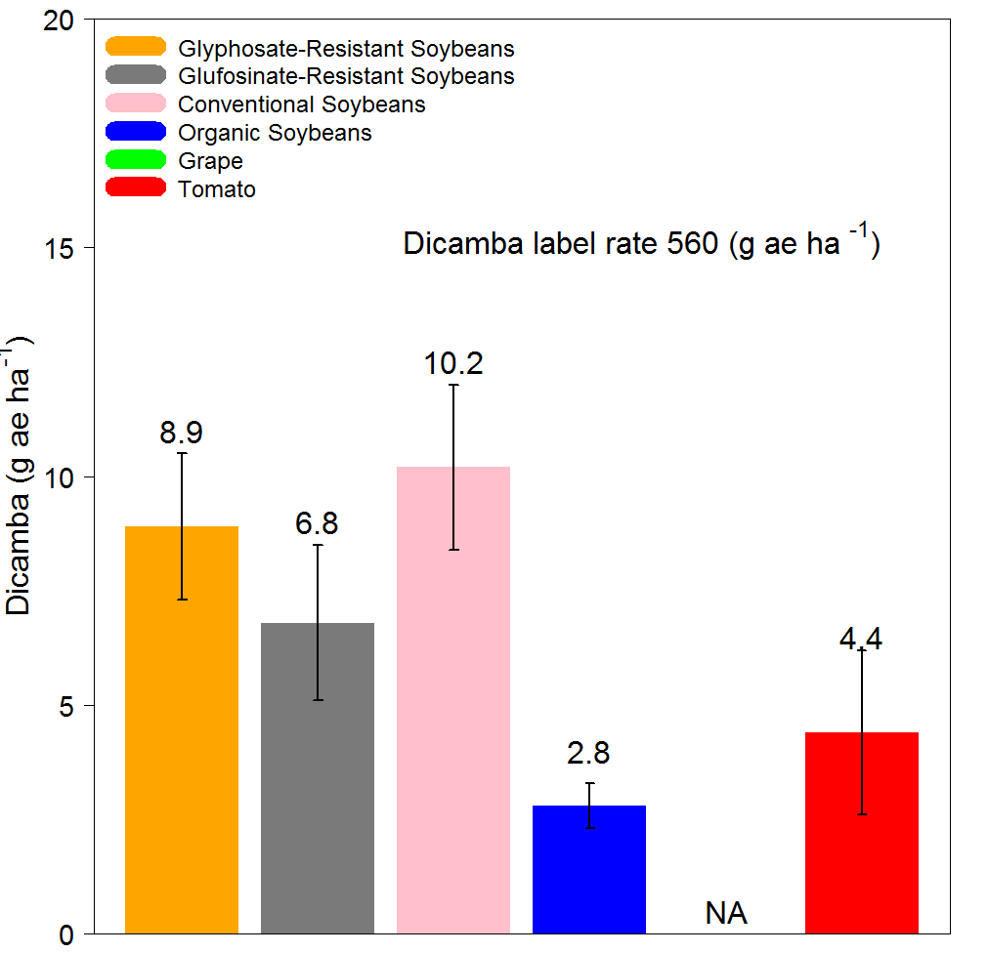
ED 30

Slide 15
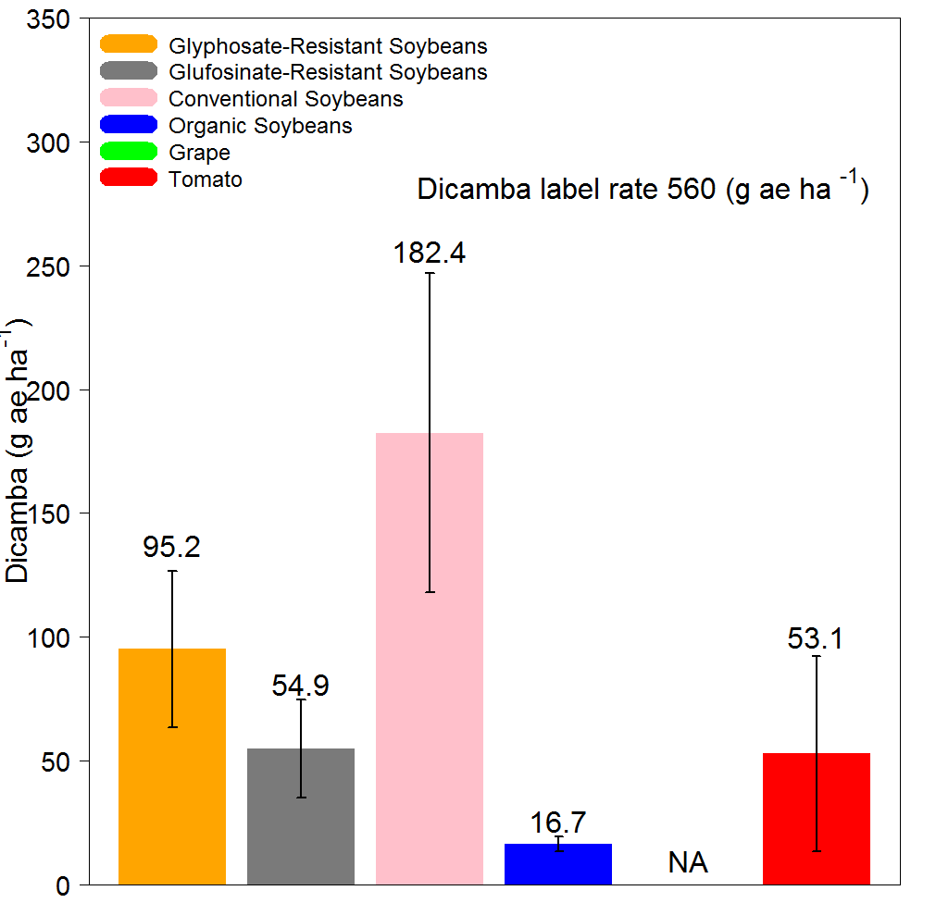
ED 50

Slide 16
Comparison between varieties
21 DAT
2nd Trifoliate vs R2
Dicamba (g ae ha⁻¹)

Slide 17
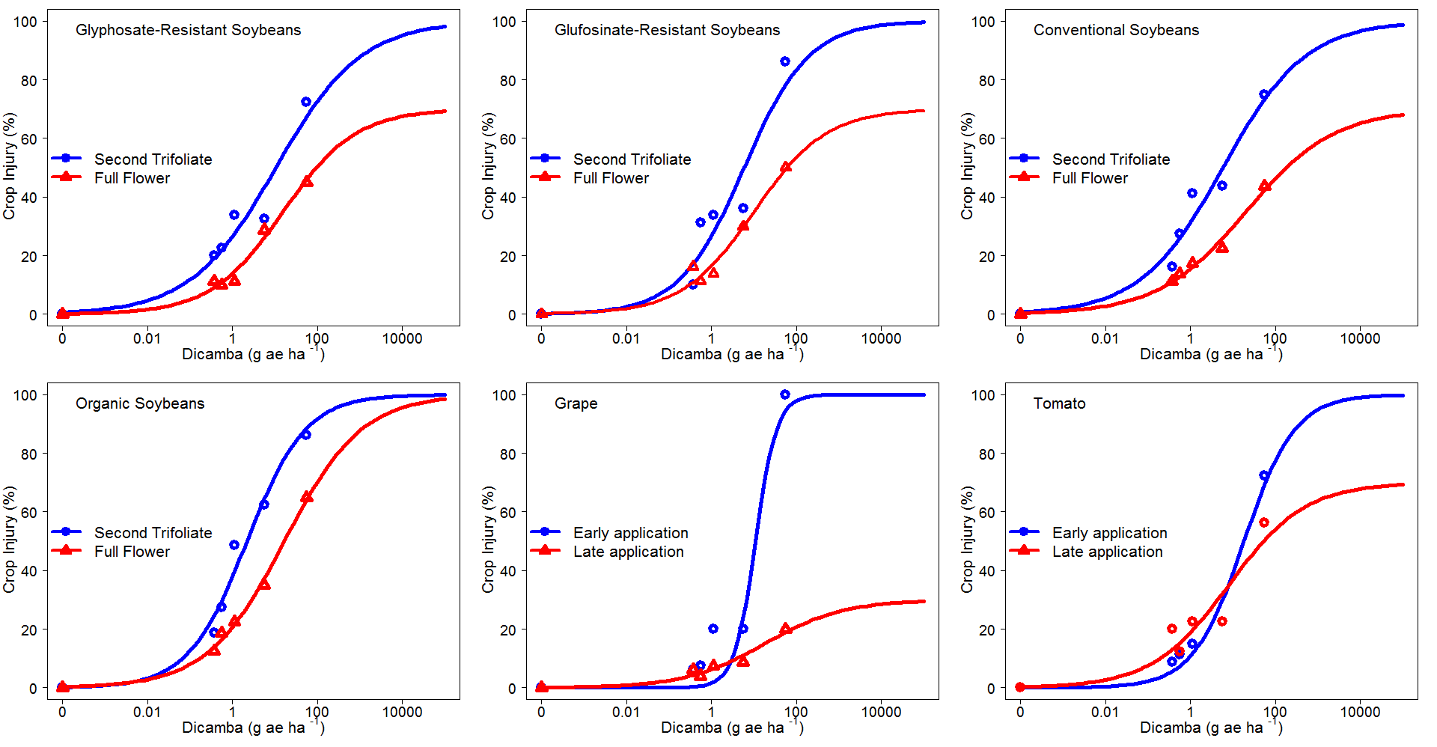

Slide 18
21 DAT
Application at 2nd Trifoliate
Clarity (oz acre⁻¹)

Slide 19
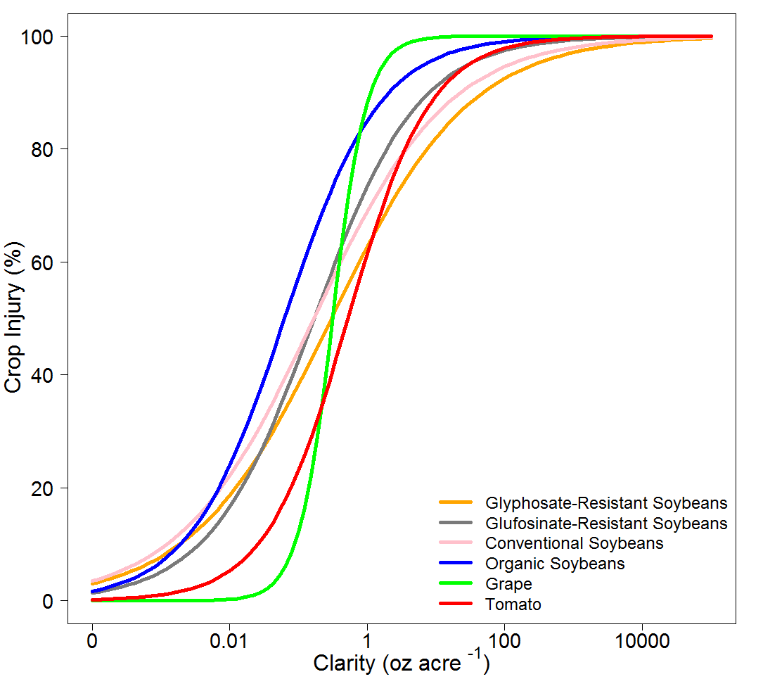

Slide 20
ED values of Clarity (oz acre⁻¹) 21 d after application at 2nd Trifoliate
Varieties | ED10 (SE) | ED20 (SE) | ED30 (SE) | ED50 (SE)
 | oz acre ⁻¹
Glyphosate-Resistant Soybeans | 0.002 (0.001) | 0.01 (0.005) | 0.04 (0.01) | 0.3 (0.09)
Glufosinate-Resistant Soybeans | 0.003 (0.001) | 0.01 (0.004) | 0.04 (0.009) | 0.16 (0.03)
Conventional Soybeans | 0.001 (0.0006) | 0.007 (0.002) | 0.03 (0.006) | 0.16 (0.04)
Organic Soybeans | 0.002 (0.0007) | 0.006 (0.001) | 0.02 (0.002) | 0.06 (0.01)
Grape | 0.08 (0.03) | 0.14 (0.03) | 0.19 (0.03) | 0.31 (0.05)
Tomato | 0.02 (0.009) | 0.08 (0.02) | 0.16 (0.03) | 0.52 (0.09)

Slide 21
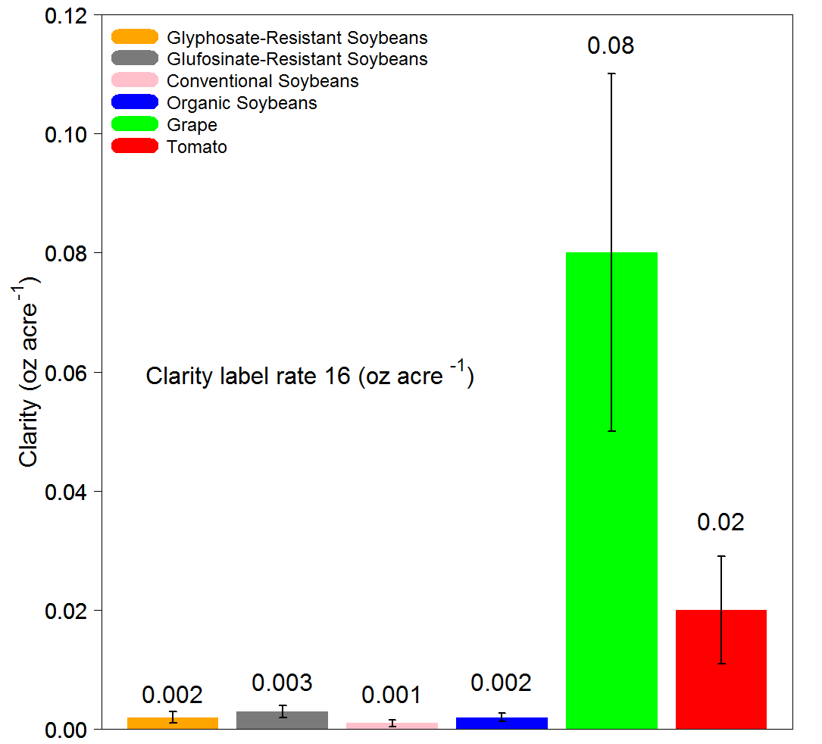
ED 10

Slide 22
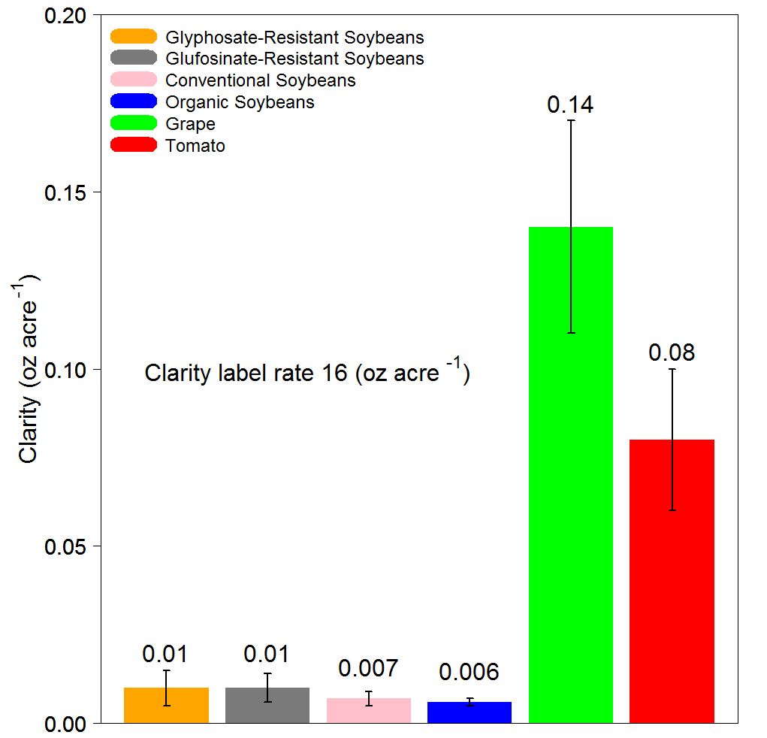
ED 20

Slide 23
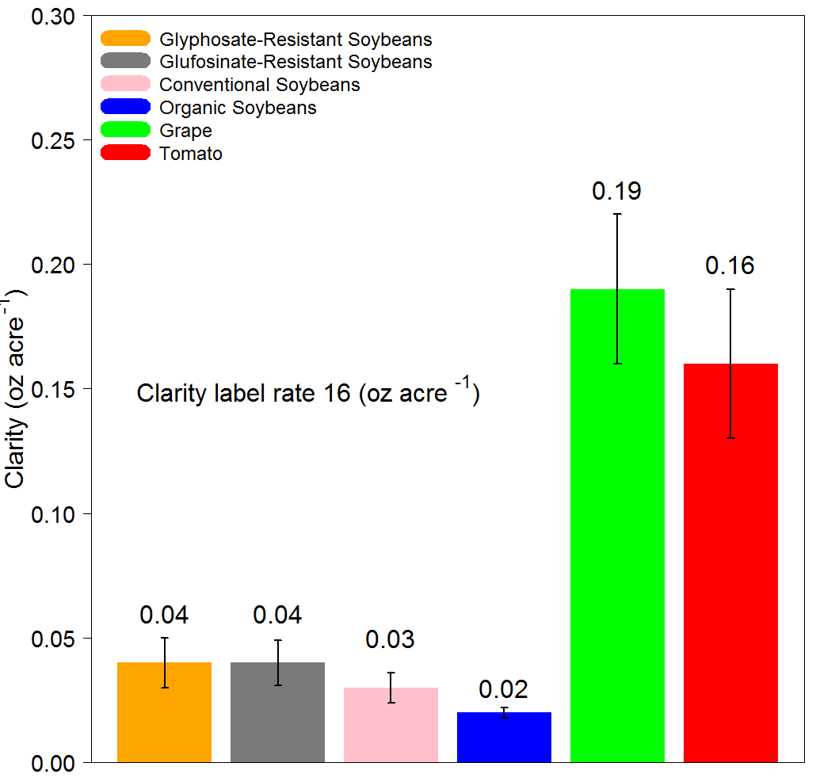
ED 30

Slide 24
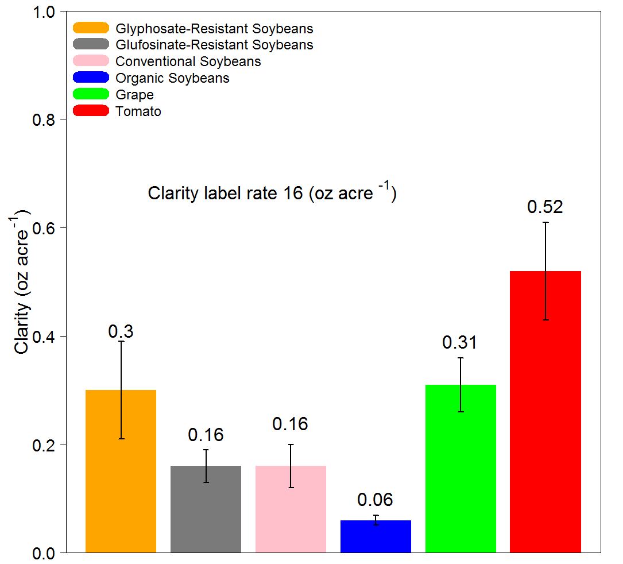
ED 50

Slide 25
21 DAT
Application at R2
Clarity (oz acre⁻¹)

Slide 26
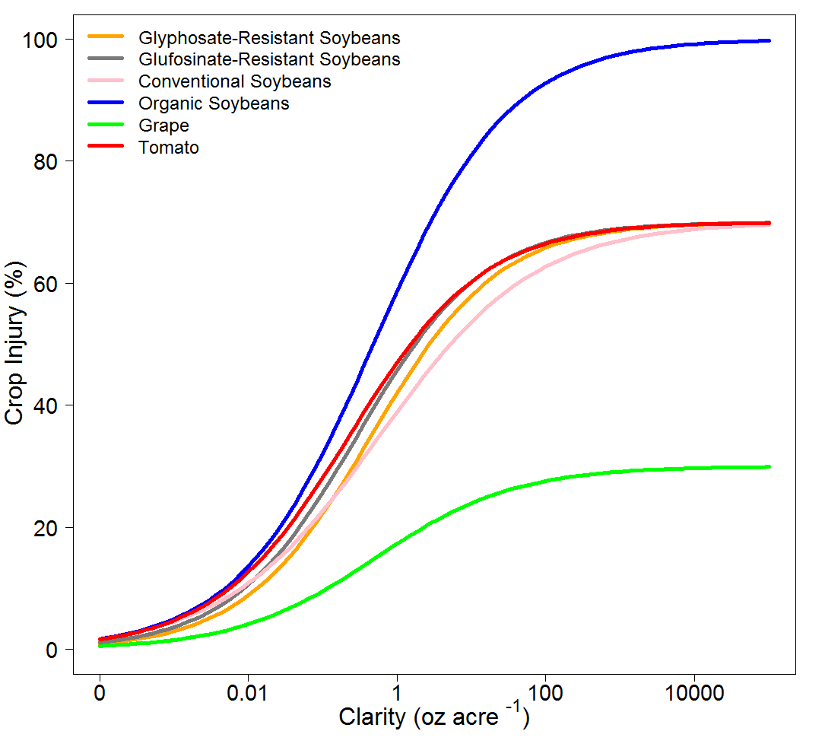

Slide 27
ED values of Clarity (oz acre⁻¹) 21 d after application at R2
Varieties | ED10 (SE) | ED20 (SE) | ED30 (SE) | ED50 (SE)
 | oz acre⁻¹
Glyphosate-Resistant Soybeans | 0.01 (0.003) | 0.07 (0.01) | 0.3 (0.04) | 2.7 (0.9)
Glufosinate-Resistant Soybeans | 0.01 (0.004) | 0.04 (0.01) | 0.2 (0.04) | 1.7 (0.8)
Conventional Soybeans | 0.01 (0.002) | 0.06 (0.01) | 1.8 (0.05) | 5.2 (1.8)
Organic Soybeans | 0.004 (0.001) | 0.03 (0.005) | 0.08 (0.01) | 0.5 (0.08)
Grape | 0.1 (0.04) | 2.3 (1.7) | NA | NA
Tomato | 0.01 (0.004) | 0.03 (0.01) | 0.1 (0.05) | 1.5 (1.1)

Slide 28
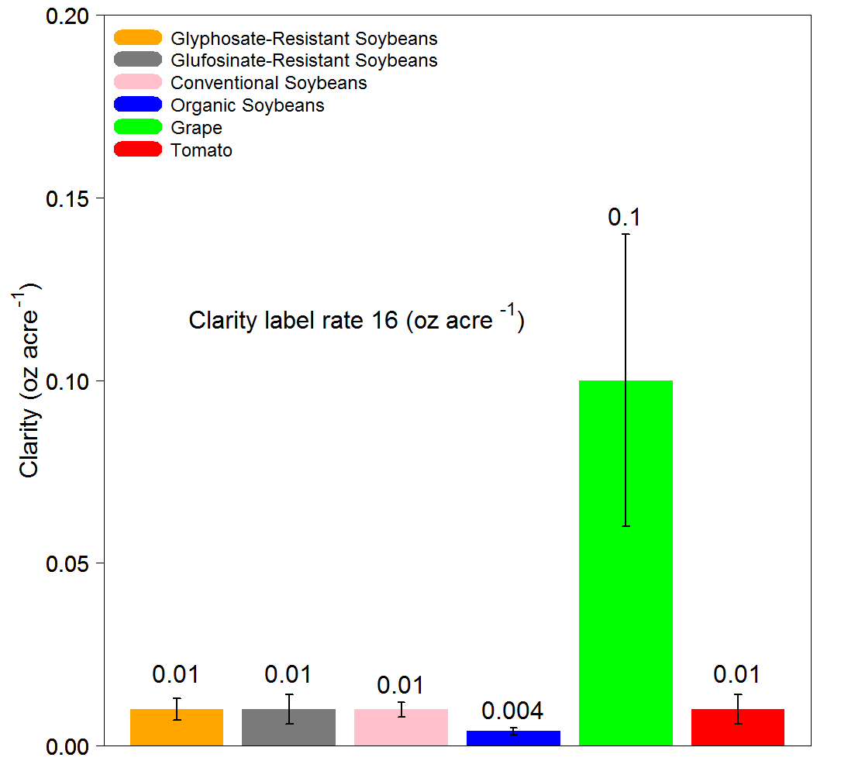
ED 10

Slide 29
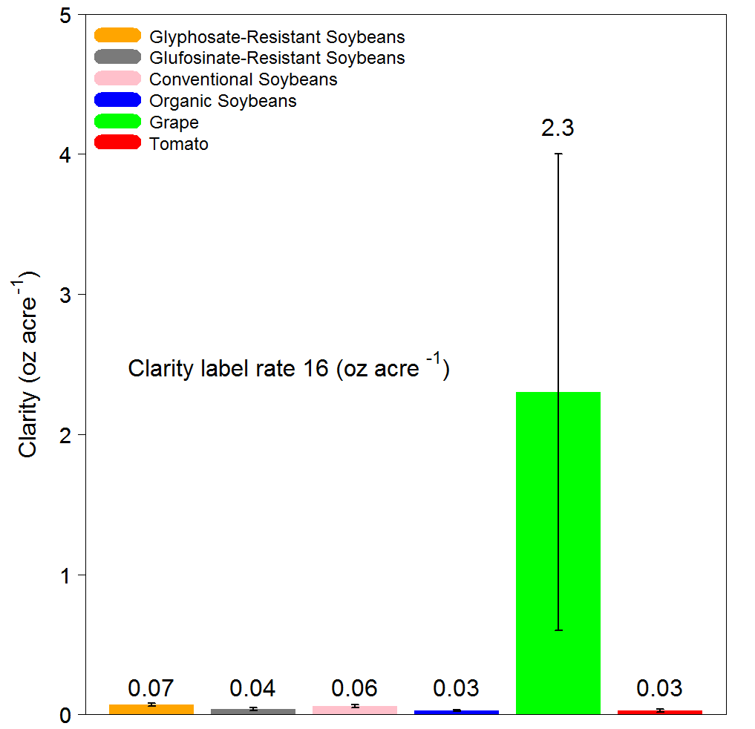
ED 20

Slide 30
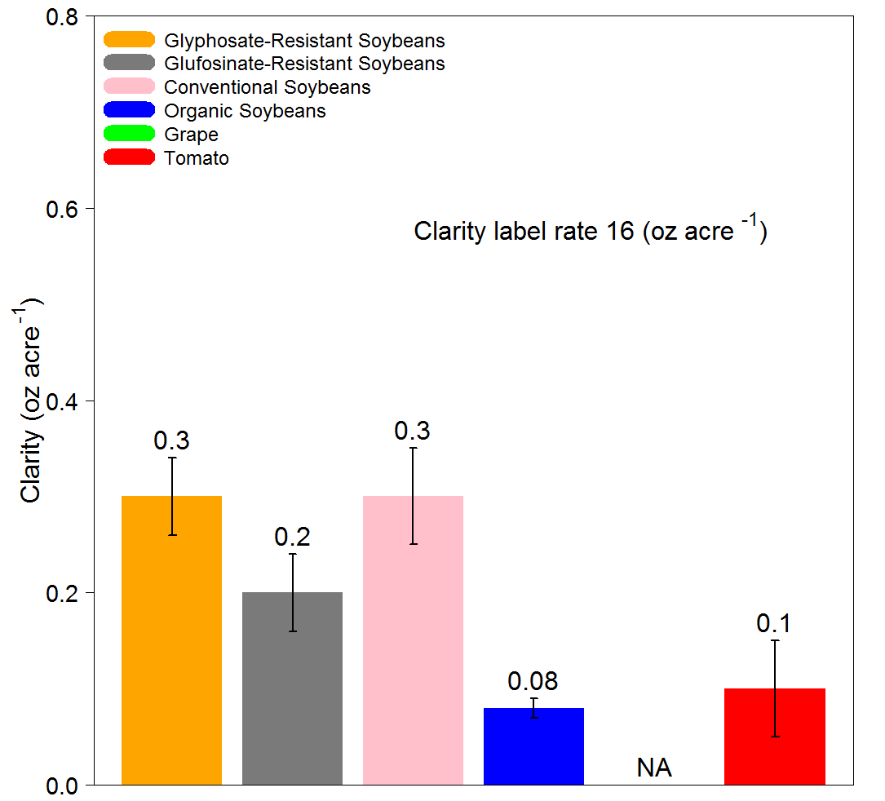
ED 30

Slide 31
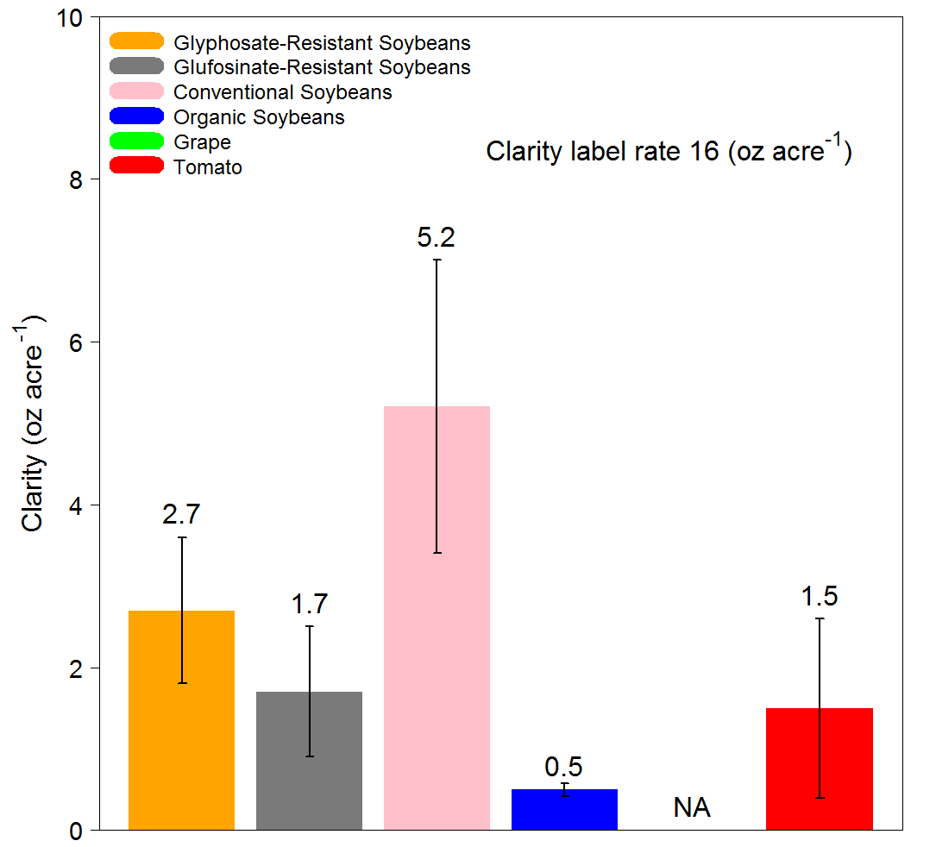
ED 50

Slide 32
Comparison between varieties
21 DAT
2nd Trifoliate vs R2
Clarity (oz acre⁻¹)

Slide 33
